Slide 1
Packaging Guidelines

Slide 2
What is packaging ?
Packaging is the technology of distribution, storage, sale, and use.
Packaging also refers to the process of designing, evaluating, and producing packages. Packaging can be described as a coordinated system of preparing goods for transport, warehousing, logistics, sale, and end use.
Packaging contains, protects, preserves, transports, informs, and sells. In many countries it is fully integrated into government, business, institutional, industrial, and personal use.
enclosing or protecting products for
---

Slide 3
Types of packaging
Packaging may be of several different types. For example, a transport package or distribution package can be the shipping container used to ship, store, and handle the product or inner packages. Some identify a consumer package as one which is directed toward a consumer or household.
It is sometimes convenient to categorize packages by layer or function: "primary", "secondary", etc.
Primary packaging is the material that first envelops the product and holds it. This usually is
the smallest unit of distribution or use and is the package which is in direct contact with the contents.
Secondary packaging is outside the primary packaging, and may be used to prevent pilferage or to group primary packages together.
Tertiary packaging is used for bulk handling, warehouse storage and transport shipping. The most common form is a palletized unit load that packs tightly into containers.
--

Slide 4
What is primary packaging ?
Primary packaging is the term used to designate the layer of packaging in immediate contact with the product; in other words, it is the first packaging layer in which the product is contained.
As such, primary packaging is constructed both with the product itself and any existing secondary layers of packaging in mind. The properties of the product (form, dimensions and consistency) evidently dictate the main priorities of primary packaging.
The examples of primary packaging are as limitless as the range of available consumer products. Some of the most common types include blister packs, clamshell packaging, shrink-wrapping, paperboard packaging, unit dose packs and many more

Slide 5
What is secondary packaging ?
As secondary packaging is not in direct contact with the actual product, its use and application usually differ distinctly from those of primary packaging, although the purpose of both types may at times converge. Secondary packaging can be said to have two central functions:
Branding & Display. Secondary packaging plays a vital role in the marketing strategy surrounding the product. This is especially relevant in the case of display packaging.
Logistics. Secondary packaging serves to group several products together for ease of handling, transport and storage. This means that secondary packaging must be able to
contain relatively large volumes of primary packaged products.
transport the product safely to its retail or consumer destination.
Secondary packaging is intended to protect not only the product, but also the primary packaging, which often is the packaging most visible to the consumer in retail displays.
The most common examples of secondary packaging include cardboard cartons, cardboard boxes and cardboard/plastic crates.

Slide 6
General Packaging Guidelines – Mebelkart
General Packing Methods follow these two most popular packing methods
These are shared to you to reduce the damages due to poor packaging Issue.
Disclaimer:
These are a set of guidelines to ensure good quality packing and packaging requirements for each product may change according to the nature of the product, the requirement of the packaging may change from product to product the need of which is left to the vendor’s discretion for extra padding.

Slide 7
Packing Methods
Single Box Packing Method
Ship non-fragile products like soft goods inside a sturdy outer box.
Place goods that might be affected by dirt, water, or wet conditions inside a plastic bag.
Use the H taping method for sealing your package.
Use strong tape designed for shipping
Use a single address label that has clear, complete delivery and return information

Slide 8
Packing Methods
BOX IN BOX PACKING
For fragile products, Individually wrap them in a minimum 2" thickness of air- cellular cushioning material. (Bubble Wrap)
Wrap the inner box with 2" thickness of
air-cellular cushioning material or use at least 2" of cushioning material to fill the spaces between the inner box and outer box on the top, bottom, and all sides.

Slide 9
Packing Methods
Rolled Goods
Tightly wrap rolled goods using several layers of heavy-duty plastic film or Kraft paper and wrap with plastic packing tape.
Then wrap the address label completely around the object or use a pouch.

Slide 10
Factory packed or pre-engineered custom packages
For
Products which are pre-engineered company cartons/Branded packaging kindly ensure the Carton box is rigid and is not moist and ensure flaps are intact.
In case you find the above condition not satisfactory then kindly use Box in Box packing method (refer slide 4 )
While packing the Carton use adequate cushioning material (External Packaging) (Minimum 2 layers of Bubble wrap) to avoid traction between other products during the movement of goods.

Slide 11
For
Factory packed or pre-engineered custom packages
Use fillers like crumpled newspaper, air- cellular cushioning material such as Bubble Wrap to fill void spaces to prevent movement of goods inside the box during shipping.
Wrap items individually with cushioning material and center them in cartons away from other items and away from the sides, corners, top, and bottom of the box.

Slide 12
Recommendations for odd- or irregular- shaped shipments
Furniture are primarily of two types
Furniture
Pre-assembled
Ready to assemble (Knock-Down)

Slide 13
For Pre-assembled Furniture
Soft Styrofoam Sheets are recommended to be used, to wrap the Furniture (Internal Packing) in order to avoid scratches and tampering of products.
This will add extra cushioning to the products which will reduce the risk of product getting damaged In-transit.

Slide 14
For Pre-assembled Furniture
You may choose to use wooden crates to pack your furniture products, where the product needs such kind of packing (example: Sofas)
Kindly ensure you do sufficient internal padding before the wooden crate packing. (Use Soft Styrofoam Sheets to avoid scratches on the product)

Slide 15
For Ready to assemble (Knock-Down)Furniture
Knock Down furniture is generally packaged in a kit form with its pieces packed in one or multiple boxes. The kit consists of flat parts, screws, fixings, and other parts that are needed to assemble the furniture. This kit becomes very easy and convenient to pack and transport.

Slide 16
For Ready to assemble (Knock-Down)Furniture
Packing Knock-Down Furniture
While packing the Knock-Down Furniture use Carton boxes with use adequate cushioning material (External Packaging) (Minimum 2 layers of Bubble wrap) to avoid traction between other products during the movement of goods
On corners and along all angular surfaces kindly place cardboards for protections.
Wrap items individually with cushioning material and center them in cartons away from other items and away from the sides, corners, top, and bottom of the box.
Also Ensure the Edges of the parts are secured with thermocol so that the material can save the product from transport vibrations.

Slide 17
For Ready to assemble (Knock-Down)Furniture
Ensure proper quantity of nuts, bolts, screws, and tools should be included inside the package for assembly with detailed, easy-to- assemble instructions.
These instructions should include a listing and location of the parts and tools required for assembly.

Slide 18
Recommendations for Large Appliances
Use the Box in Box Packaging method (refer Slide 4) or to use wooden crate packing (refer slide 10) method to ensure the full safety of products
Chimneys & Hoods (Recommended Box in Box packing)
Air Conditioners & Coolers (Recommended Wooden crate packing)
Refrigerators (Recommended Wooden crate packing)
Washing machines (Recommended Box in Box
packing/ Wooden crate packing)

Slide 19
Packing Signs & Markings
Carton markings - All cartons must have: “Line-to-Concrete” marking
This identifies how product should be handled at all points of contact inclusive of loading and warehousing.
Front and back of product must be
identified on the carton.
Directional arrows should be applied wherever applicable.
--

Slide 20
Addressing and Labeling Your Package
Place Delivery information on the correct side of the package so that the information is visible and does not obstruct handling the parcel.
Place delivery information inside and outside the package.
Include an address for your recipient and yourself.
Remove or cross out any old address labels on the outer box

Slide 21
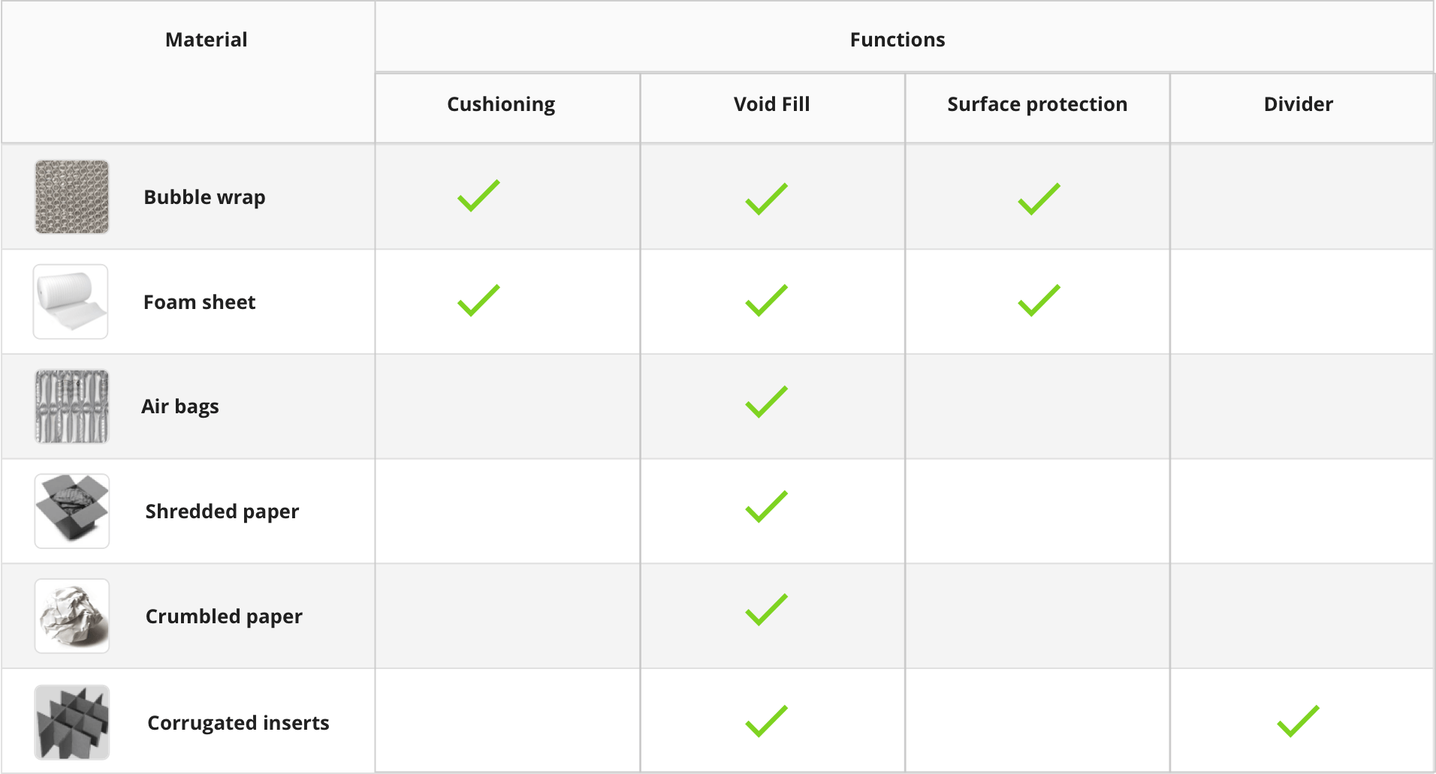
Internal Packaging Material vs Functionality

Slide 22
Thank you

